Slide 1
PROBLEM STATEMENT
DASHBOARD 1: OVERVIEW
KPI’s Requirement
Sales Overview:
Year-to-Date (YTD) Total Sales
Month-to-Date (MTD) Total Sales
Year-over-Year (YOY) Growth in Total Sales
Difference between YTD Sales and Previous Year-to-Date (PTYD) Sales
Average Price Analysis:
YTD Average Price
MTD Average Price
YOY Growth in Average Price
Difference between YTD Average Price and PTYD Average Price
Cars Sold Metrics:
YTD Cars Sold
MTD Cars Sold
YOY Growth in Cars Sold
Difference between YTD Cars Sold and PTYD Cars Sold

Slide 2
PROBLEM STATEMENT
DASHBOARD 2: DETAILS
Chart’s Requirement
1. YTD Sales Weekly Trend: Display a line chart illustrating the weekly trend of YTD sales. The X-axis should represent weeks, and the Y-axis should show the total sales amount.
2. YTD Total Sales by Body Style: Visualize the distribution of YTD total sales across different car body styles using a Pie Chart.
3. YTD Total Sales by Color: Present the contribution of various car colors to the YTD total sales through a Pie Chart.
4. YTD Cars Sold by Dealer Region: Showcase the YTD sales data based on different dealer regions using a map chart to visualize the sales distribution geographically.
5. Company-Wise Sales Trend in Grid Form: Provide a tabular grid that displays the sales trend for each company. The grid should showcase the company name along with their YTD sales figures.
6. Details Grid Showing All Care Sales Information: Create a detailed grid that present all relevant information for each car sale, including car model, body style, color, sales amount, dealer region, date, etc.

Slide 3
PROBLEM STATEMENT
DASHBOARD 2: DETAILS
Create a Grid View dashboard displaying a table of all details in Power BI.
This should allow a user to export the grid for various filters applied.

Slide 4
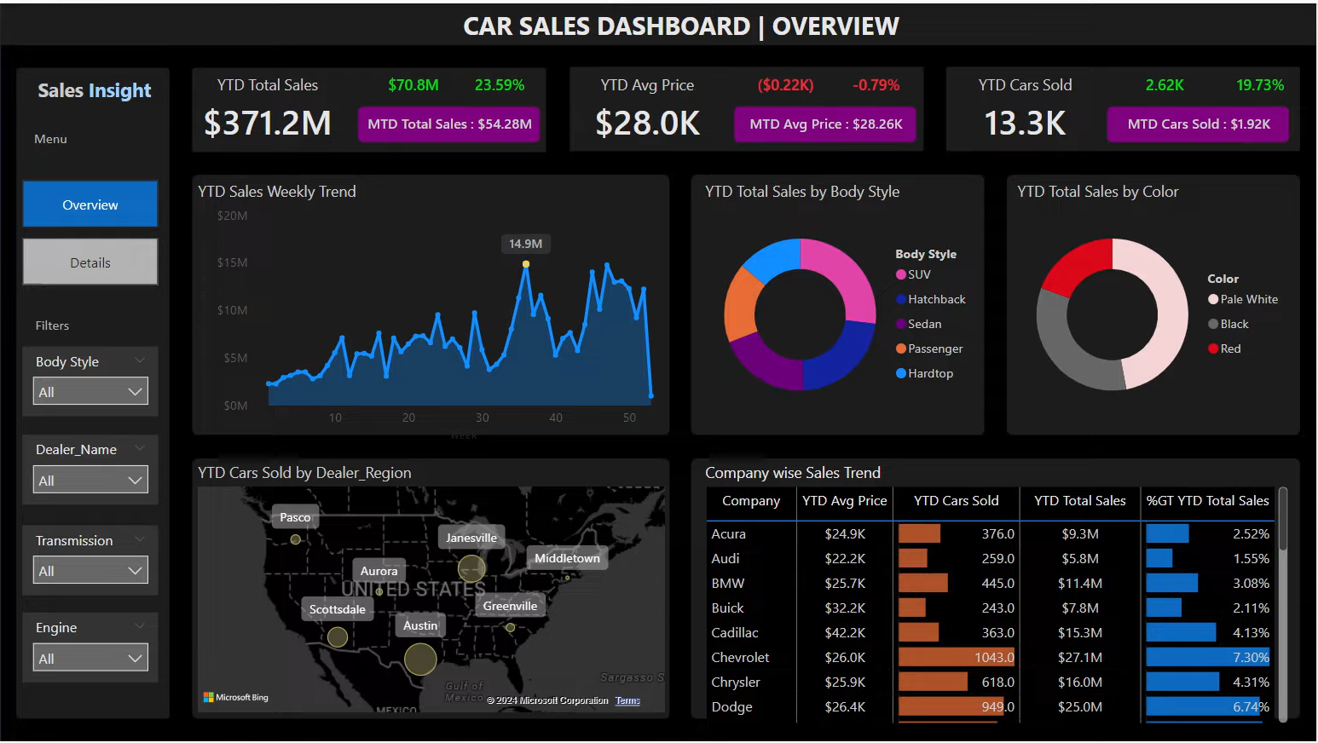
DASHBOARD

Slide 5
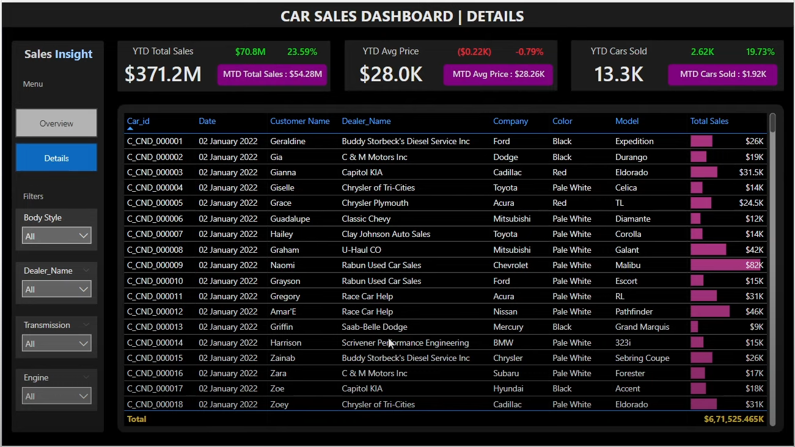
DASHBOARD

Slide 6
FUNCTIONALITIES
Connecting to Excel File
Data Cleaning
Data Modelling
Data Processing
Power Query
Data Tables
DAX
Time Intelligence Function
YTD, MTD, PYTD
MAX, MAXX, RANK
Date Function
Custom Charts
Text Function
Filter Function
Calculate
SUM/SUMX
Conditional Formatting’s
Maps & Custom Maps
Creating KPI’s
New Card Visual
Creating Charts
Formatting Visuals
Creating Functions
Navigations

Slide 7
SOFTWARES USED
1. MS Excel: VERSION 2021
2. Power BI: Dec 2023 Version

Slide 8
Thank You

